Slide 1
SEMICONDUCTORS
Dr. Archana Sharma

Slide 2
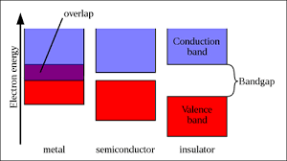
STATES OF MATTER
Solids
Liquids
Gas
Conductors
Semiconductors
Insulators
Band Gap values
Conductors: VB and CB overlaps
Semiconductors: ~1-3 eV
Insulators: > 5eV

Slide 3
DOPING IN SEMICONDUCTORS
Semiconducting materials are very sensitive to impurities in the crystal lattice.
The controlled addition of these impurities is known as doping.
Allows the tuning of the electronic properties: technological applications.
Pure semiconductor are called ‘intrinsic’.
Introduction of dopants →’extrinsic semiconductors’.
Introduction of dopants → (i) new intra-band, energy levels
(ii) Generation of positive or negative charge carriers.

Slide 4
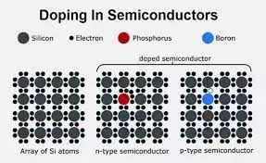
Extrinsic Semiconductors-
(i) n-type: Pentavalent impurity- electrons as majority charge carriers (Donor Atoms)
(ii) p-type: Trivalent impurity- holes as majority charge carriers (Acceptor atoms)
https://www.quora.com/Why-is-doping-required-in-a-semiconductor

Slide 5
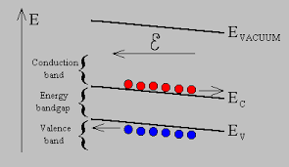
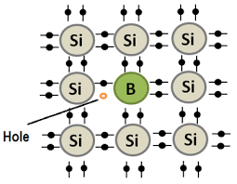
CONCEPT OF HOLES
A hole can be seen as the "opposite" of an electron.
Holes have a positive charge.
They are the absence of an electron in an atom (not physical particles).
They are formed when electrons in atoms move out of the valence band to the conduction band.
Holes can move from atom to atom in semiconducting materials as electrons leave their positions.
https://ecee.colorado.edu/~bart/book/eband4.htm

Slide 6
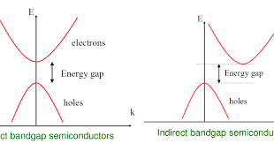
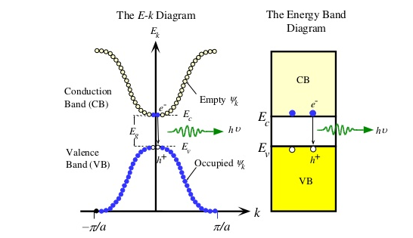
BAND GAP IN SEMICONDUCTORS
Direct gap is important in optoelectronics as direct band gap materials have efficient radiative absorption and emission, which is what makes LEDs and laser diodes work
An E-k diagram shows characteristics of a particular semiconductor material.
It shows the relationship between the energy and momentum of available quantum mechanical states for electrons in the material.
http://edetec106.blogspot.com/2016/01/differentiate-between-direct-and.html
https://www.slideshare.net/chinkitkit/chapter-4a-36657201

Slide 7
EFFECTIVE MASS
The effective mass represents the effect of all the internal forces on the motion of the electron in the conduction band.
Assumption: Mass of electron in solid is same as the mass of a free electron.
Experimentally: In some solids, electron mass is more while for some it is less than the free electron mass.
Effective mass: Experimentally determined electron mass.
Reason: Interaction between the drifting electrons and the atoms in the solids.
Sign of effective mass: determined from the sign of curvature of the E-k curve.

Slide 8
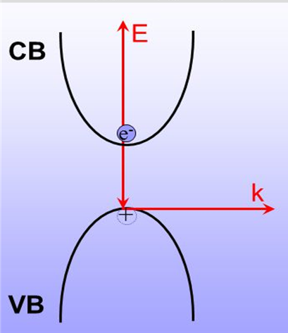
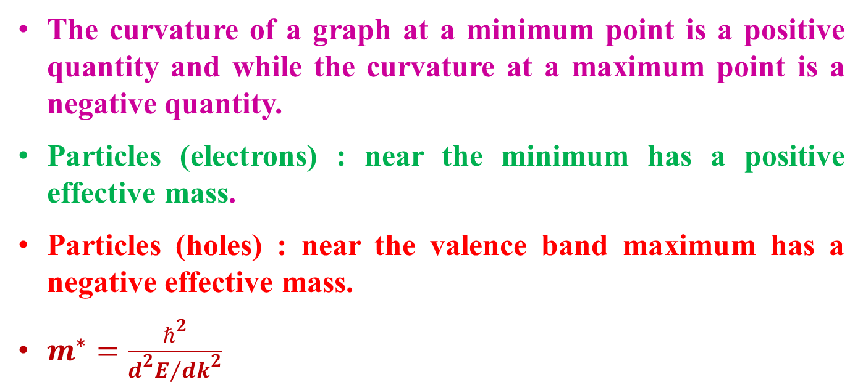
The curvature of a graph at a minimum point is a positive quantity and while the curvature at a maximum point is a negative quantity.
Particles (electrons) : near the minimum has a positive effective mass.
Particles (holes) : near the valence band maximum has a negative effective mass.
$m^{∗}=\frac{ℏ^{2}}{{d^{2}E}/{{dk}^{2}}}$

Slide 9
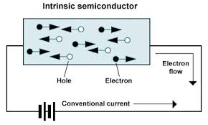
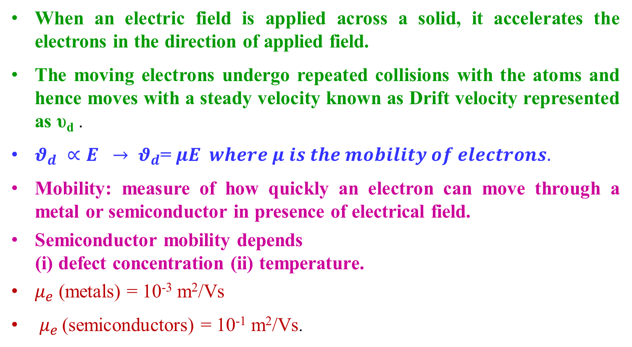
MOBILITY
When an electric field is applied across a solid, it accelerates the electrons in the direction of applied field.
The moving electrons undergo repeated collisions with the atoms and hence moves with a steady velocity known as Drift velocity represented as υ_{d} .
$θ_{d} ∝E → θ_{d}$= $μE where μ is the mobility of electrons.$
Mobility: measure of how quickly an electron can move through a metal or semiconductor in presence of electrical field.
Semiconductor mobility depends
(i) defect concentration (ii) temperature.
$μ_{e}$ (metals) = 10⁻³ m²/Vs
$μ_{e }$(semiconductors) = 10⁻¹ m²/Vs.

Slide 10
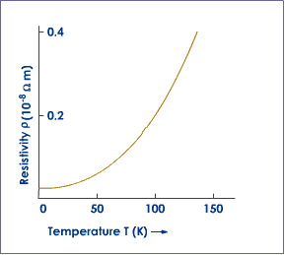
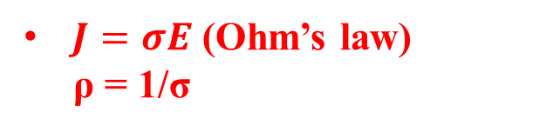
CONDUCTIVITY IN METALS
Conductivity is attributed to free-charge carriers in metals.
Increase in temperature → increases the vibrations of the metal ions.
Increased vibrations → causes frequent collisions between the electrons → drains out energy of the free electrons → restricts the movement of the delocalized electrons → drift velocity decreases → resistivity of the metal increases → current decreases → conductivity of the material decreases.
$J=σE$ (Ohm’s law)
ρ = 1/σ
The temperature dependence is given as
ρ_{t} = ρ₀ [ 1 + α (T – T₀)
https://www.askiitians.com/iit-jee-electric-current/temperature-dependence-of-resistivity/

Slide 11
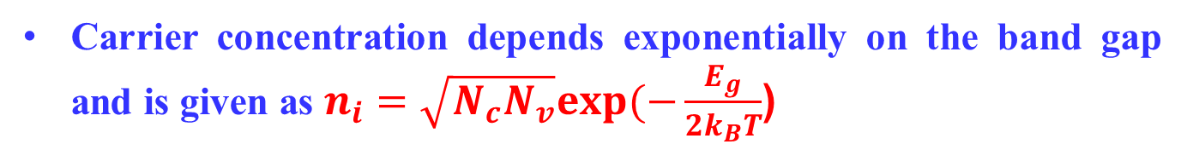
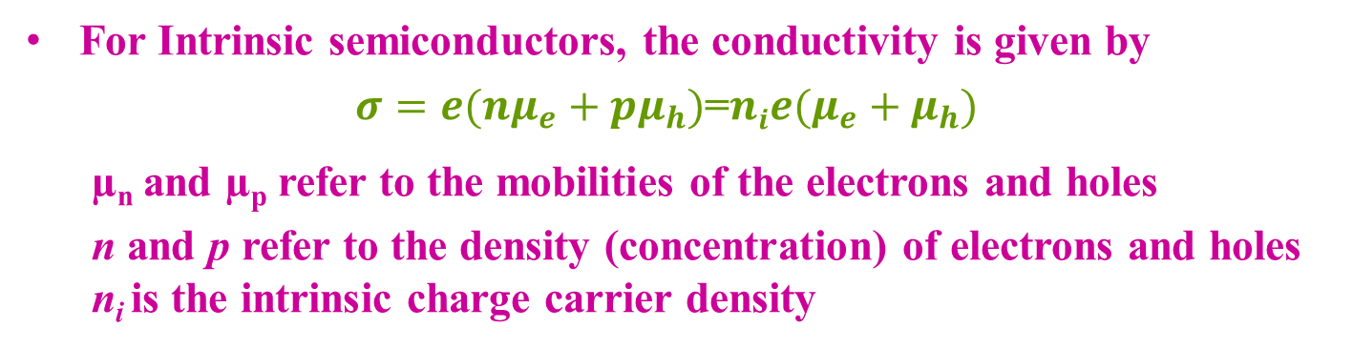
CONDUCTIVITY IN INTRINSIC SC
For Intrinsic semiconductors, the conductivity is given by
$σ=e({nμ}_{e}+pμ_{h})$=$nie(μ_{e}+μ_{h})$
µ_{n} and µ_{p} refer to the mobilities of the electrons and holes
n and p refer to the density (concentration) of electrons and holes
n_{i} is the intrinsic charge carrier density
The electrons in the valance band gains energy → moves to higher energy levels in the conduction band → becomes charge carriers
Carrier concentration depends exponentially on the band gap and is given as $n_{i}=\sqrt{N_{c}N_{v}}exp(−\frac{E_{g}}{2k_{B}T}$)

Slide 12
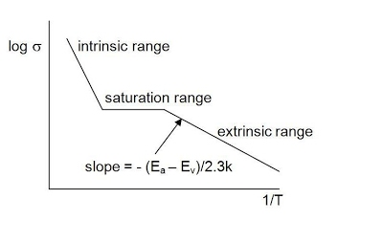
CONDUCTIVITY IN EXTRINSIC SC
Low temperature → frozen charge carriers → resistivity is extremely high.
Moderate increase in temperature → Rapid decrease in resistivity with the increase of ionized charges.
At sufficiently high temperature → dopants are completely ionized → conductivity decreases and the resistivity increases again.
At still higher temperature → resistivity decreases sharply due to appreciable excitation of all carriers and crossing the energy gap.

Slide 13
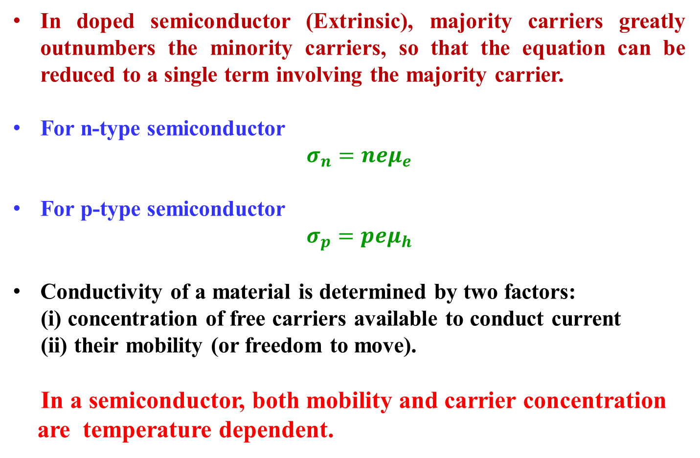
In doped semiconductor (Extrinsic), majority carriers greatly outnumbers the minority carriers, so that the equation can be reduced to a single term involving the majority carrier.
For n-type semiconductor
$σ_{n}=neμ_{e}$
For p-type semiconductor
$σ_{p}=peμ_{h}$
Conductivity of a material is determined by two factors:
(i) concentration of free carriers available to conduct current
(ii) their mobility (or freedom to move).
In a semiconductor, both mobility and carrier concentration
are temperature dependent.

Slide 14
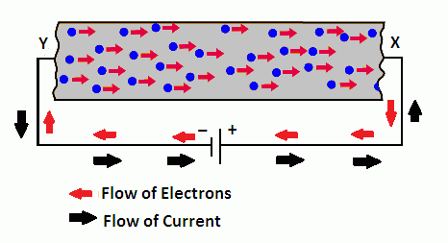
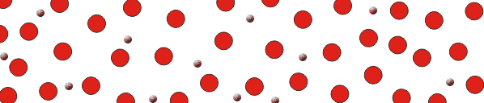
DRIFT CURRENT
Absence of field: free electrons move in a conductor with random velocities and random directions.
Presence of field: the randomly moving electrons experience an electrical force in the direction of the field.
Electrons shift towards higher potential with their random motion.
The electrons will drift towards higher potential along with their random motions.
https://web2.ph.utexas.edu/~coker2/index.files/current.htm

Slide 15
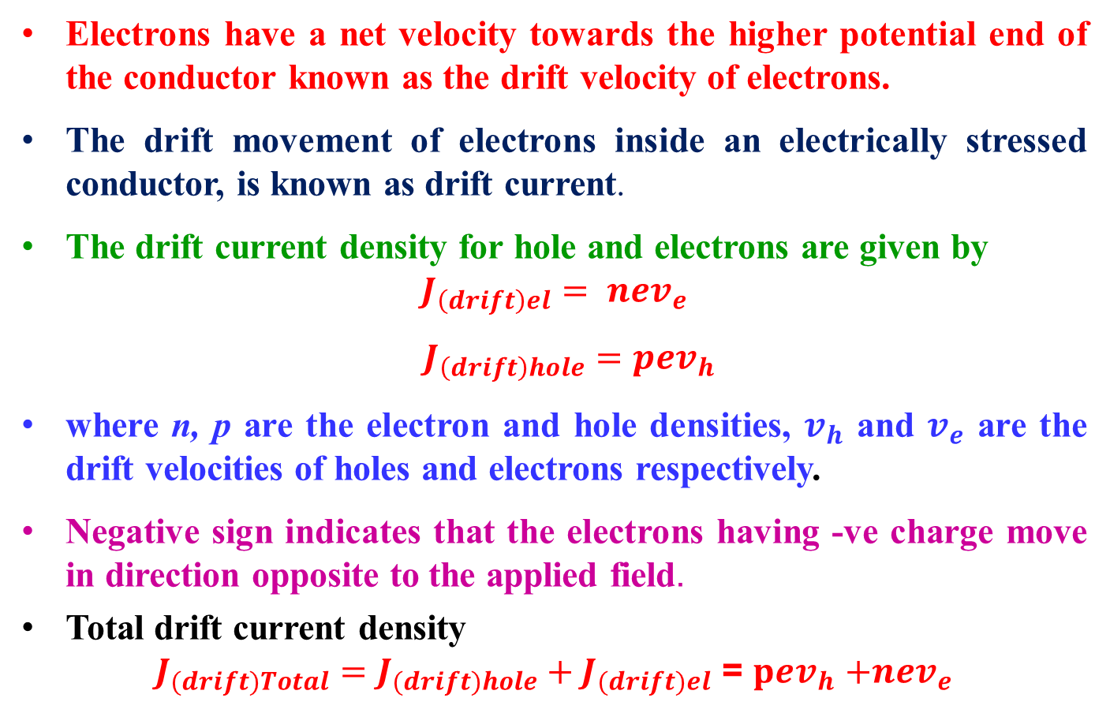
Electrons have a net velocity towards the higher potential end of the conductor known as the drift velocity of electrons.
The drift movement of electrons inside an electrically stressed conductor, is known as drift current.
The drift current density for hole and electrons are given by $J_{\left(drift\right)el}= nev_{e}$
$J_{\left(drift\right)hole}=pev_{h}$
where n, p are the electron and hole densities, $v_{h}$ and $v_{e}$ are the drift velocities of holes and electrons respectively.
Negative sign indicates that the electrons having -ve charge move in direction opposite to the applied field.
Total drift current density
$J_{(drift)Total}=J_{(drift)hole}+J_{(drift)el}$ = $pev_{h}$ $+{nev}_{e}$

Slide 16
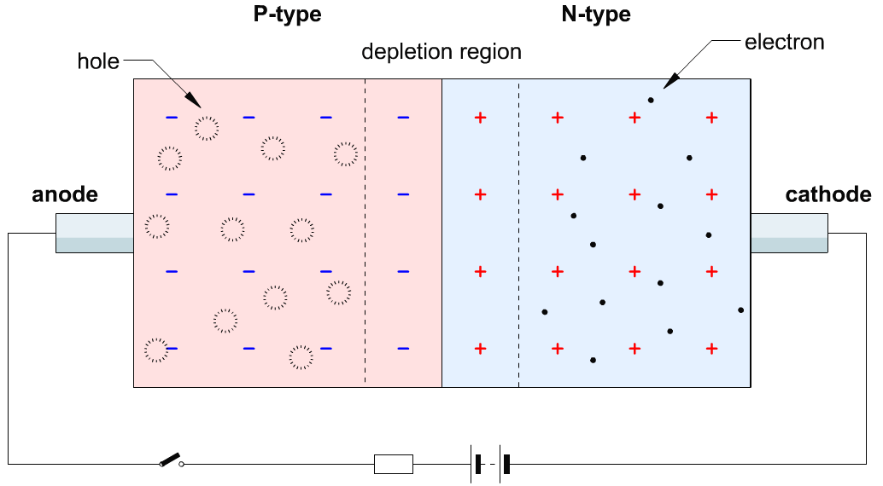
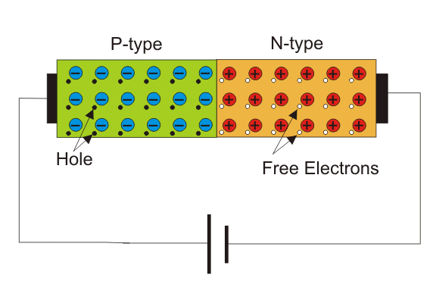
DIFFUSION CURRENT
In semiconducting material → Dopants are introduced to some region → even distribution of carriers takes place to maintain the uniformity → known as diffusion process
Movement of the mobile charge carriers are responsible for the flow of diffusion current from one region to the other.
No source of energy is required diffusion current.
http://semesters.in/v-i-characteristics-of-p-n-junction-diode-notes-for-electronics-engineering

Slide 17
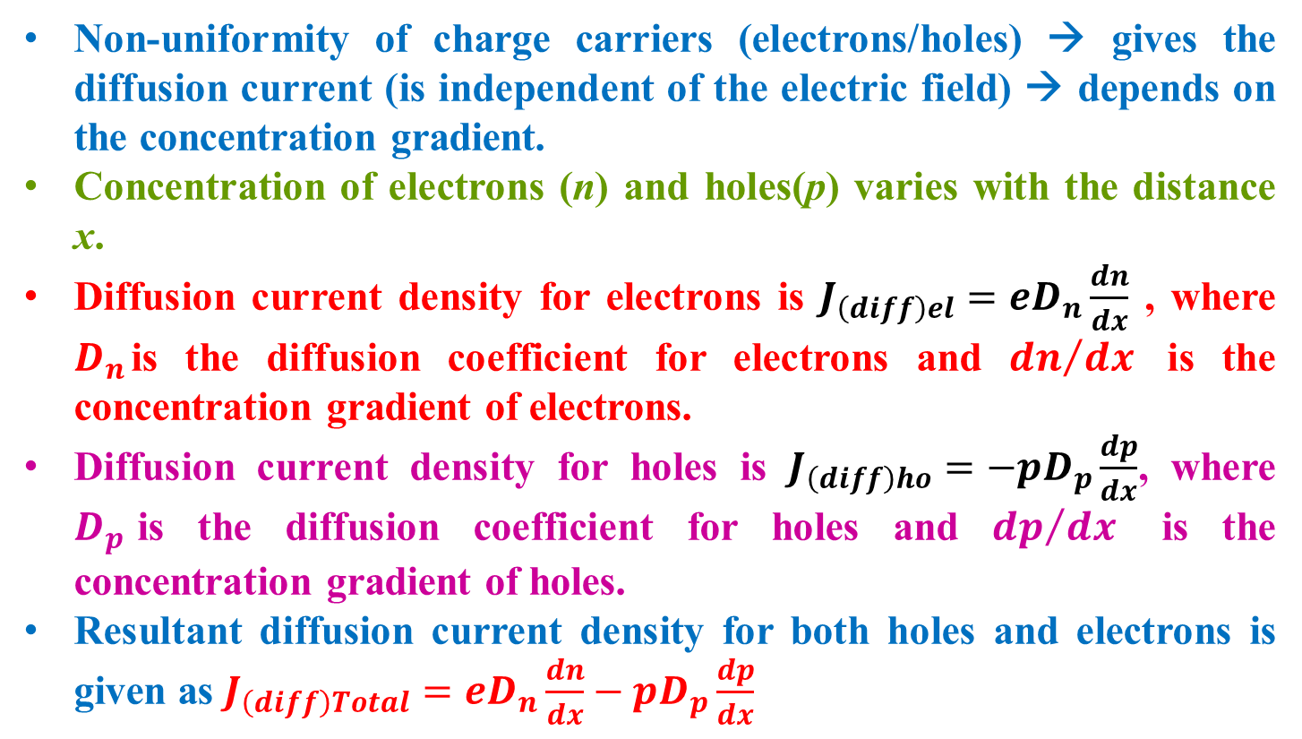
DIFFUSION CURRENT
Non-uniformity of charge carriers (electrons/holes) → gives the diffusion current (is independent of the electric field) → depends on the concentration gradient.
Concentration of electrons (n) and holes(p) varies with the distance x.
Diffusion current density for electrons is $J_{\left(diff\right)el}=eD_{n}\frac{dn}{dx}$ , where $D_{n}$is the diffusion coefficient for electrons and ${dn}/{dx}$ is the concentration gradient of electrons.
Diffusion current density for holes is $J_{\left(diff\right)ho}=−pD_{p}\frac{dp}{dx}$, where $D_{p}$is the diffusion coefficient for holes and ${dp}/{dx}$ is the concentration gradient of holes.
Resultant diffusion current density for both holes and electrons is given as $J_{\left(diff\right)Total}={eD}_{n}\frac{dn}{dx}−pD_{p}\frac{dp}{dx}$

Slide 18
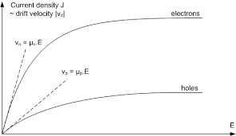
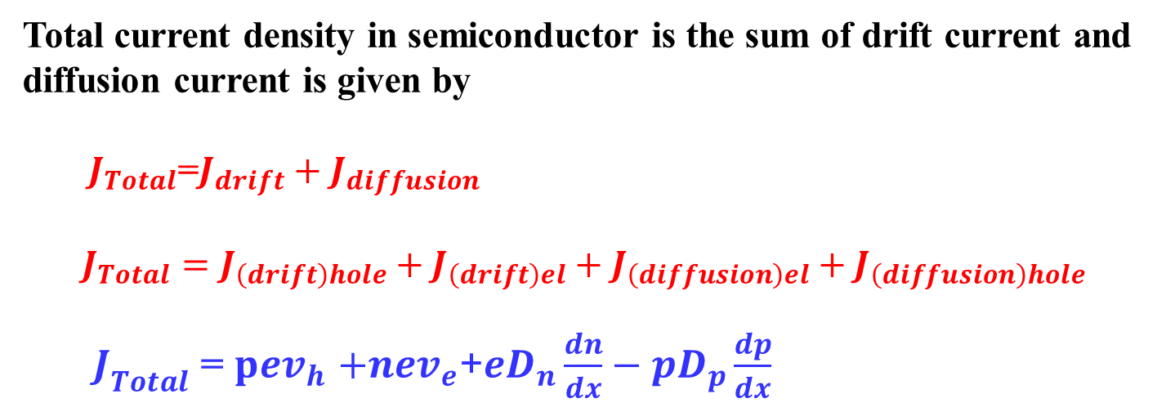
TOTAL CURRENT DENSITY
Total current density in semiconductor is the sum of drift current and diffusion current is given by
${ J}_{Total}$=$J_{drift}+J_{diffusion}$
$$J_{Total}=J_{\left(drift\right)hole}+J_{\left(drift\right)el}+J_{\left(diffusion\right)el}+J_{\left(diffusion\right)hole}$$
$J_{Total}$ = $pev_{h}$ $+{nev}_{e}$+${eD}_{n}\frac{dn}{dx}−pD_{p}\frac{dp}{dx}$
Figure shows the plot for the current density J_{drift} and the absolute value of the drift velocity, over the electric field E. The mobility of holes and electrons can be evaluated using the tangential of the drift velocity.
http://lamp.tu-graz.ac.at/~hadley/psd/problems/diffusioncurrent2/s.pdf

